Slide 1
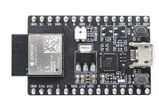

02112 Embedded Systems Programming Project
Group 1:
Bertram S235474 Dejan S235470 Mads S235472 Sebastian S235475
Smart Plant Sensor

Slide 2
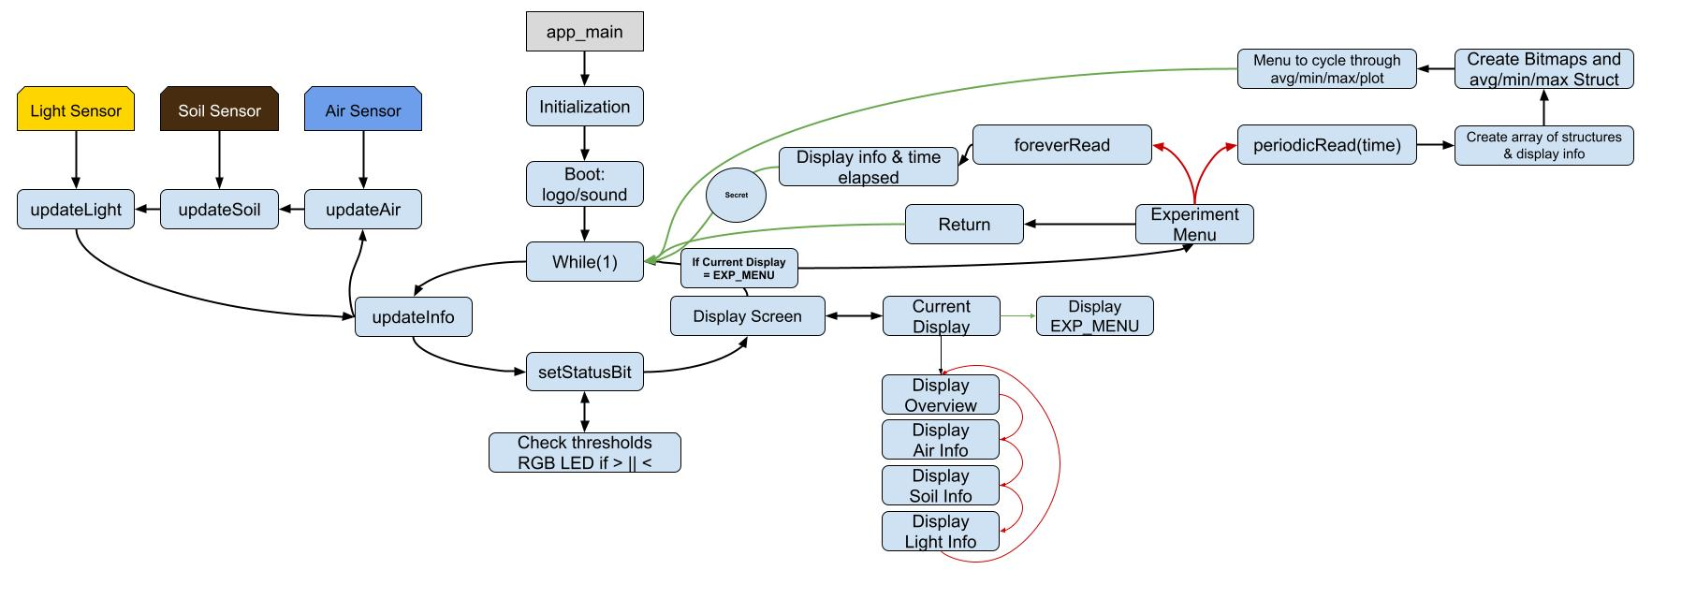
Flowchart

Slide 3
Datacollection: Inside to outside (Dusk)

Slide 4
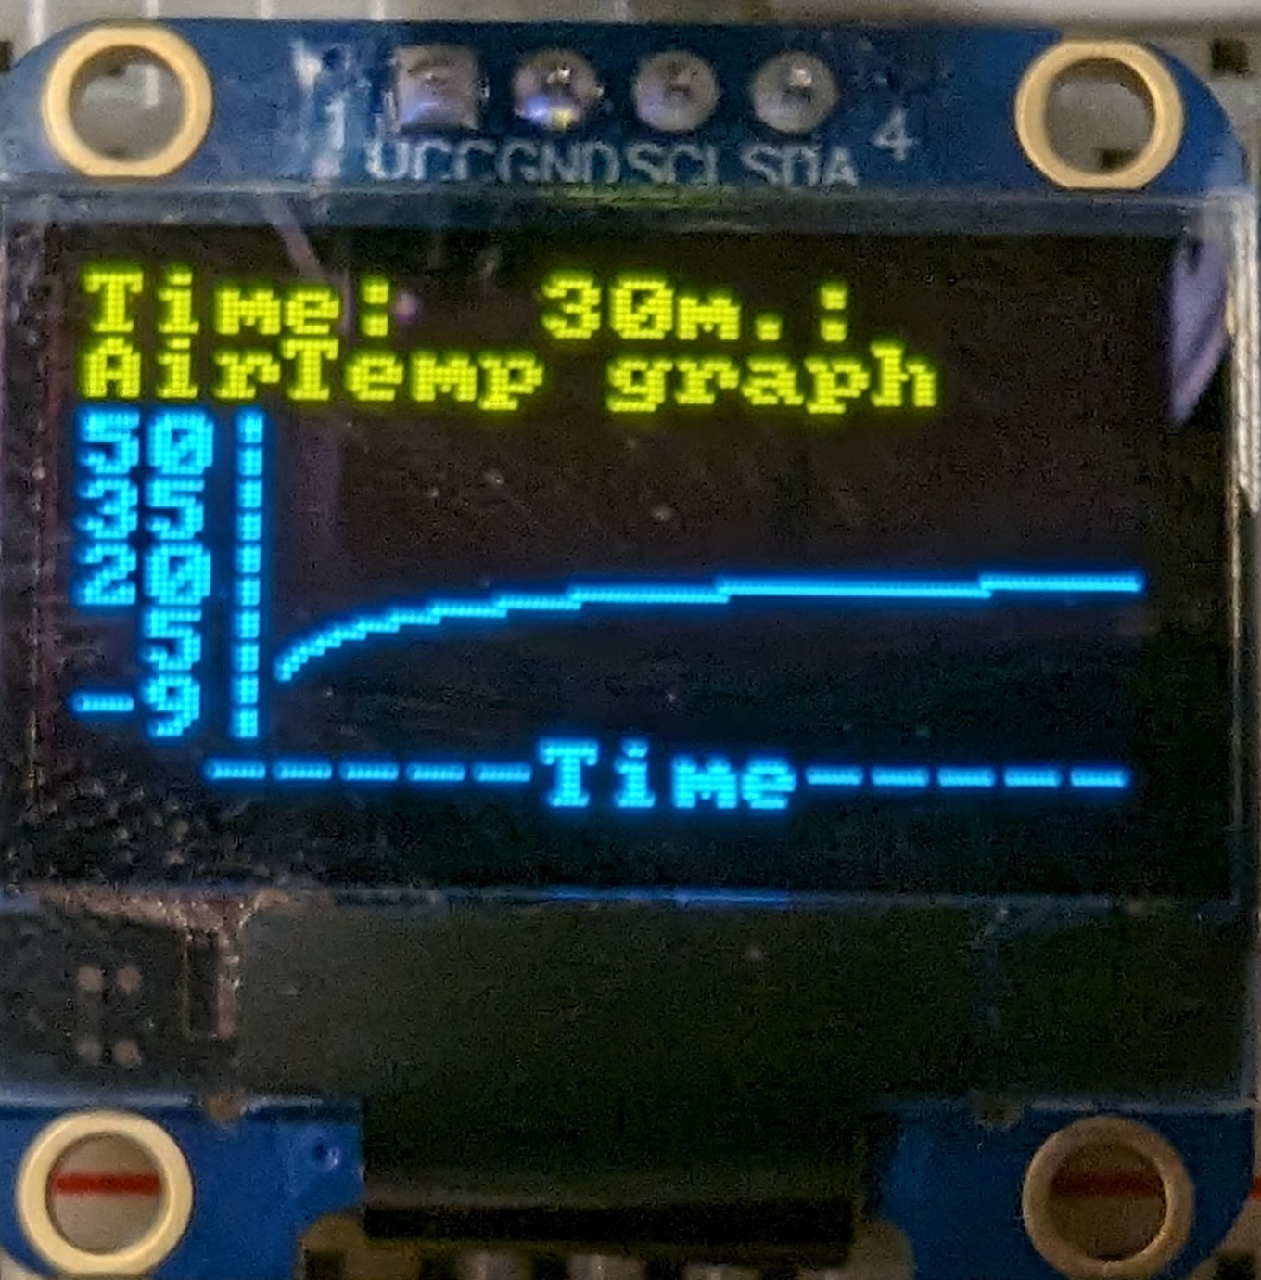
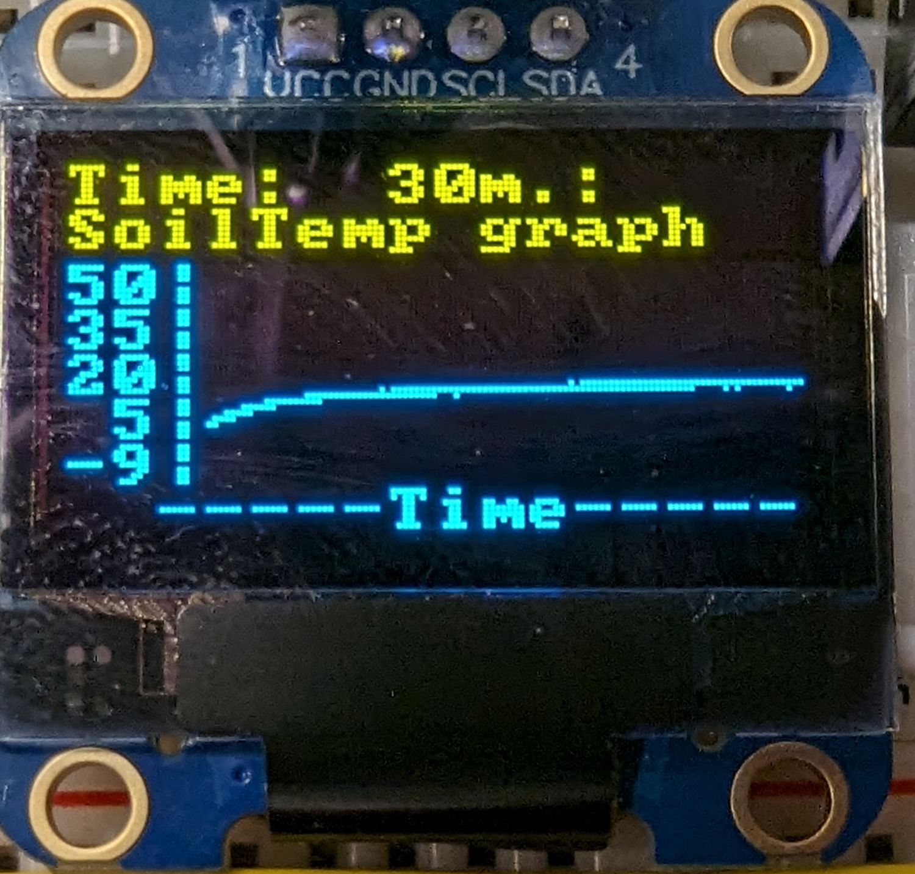
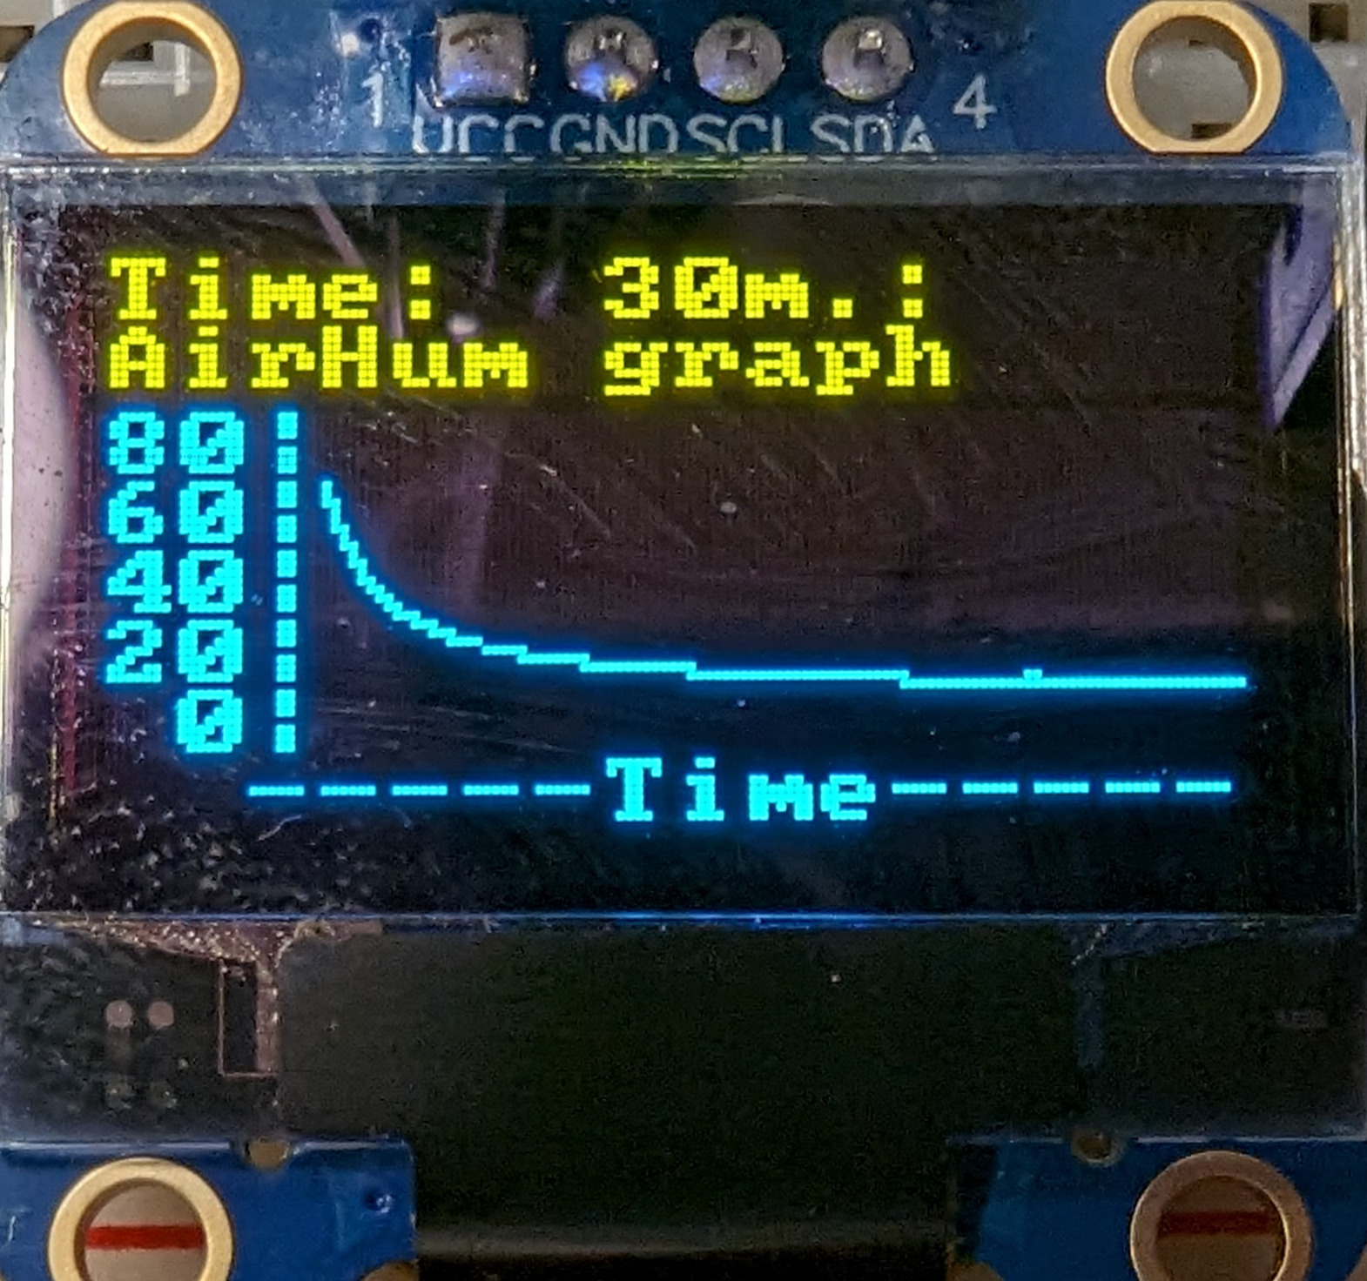
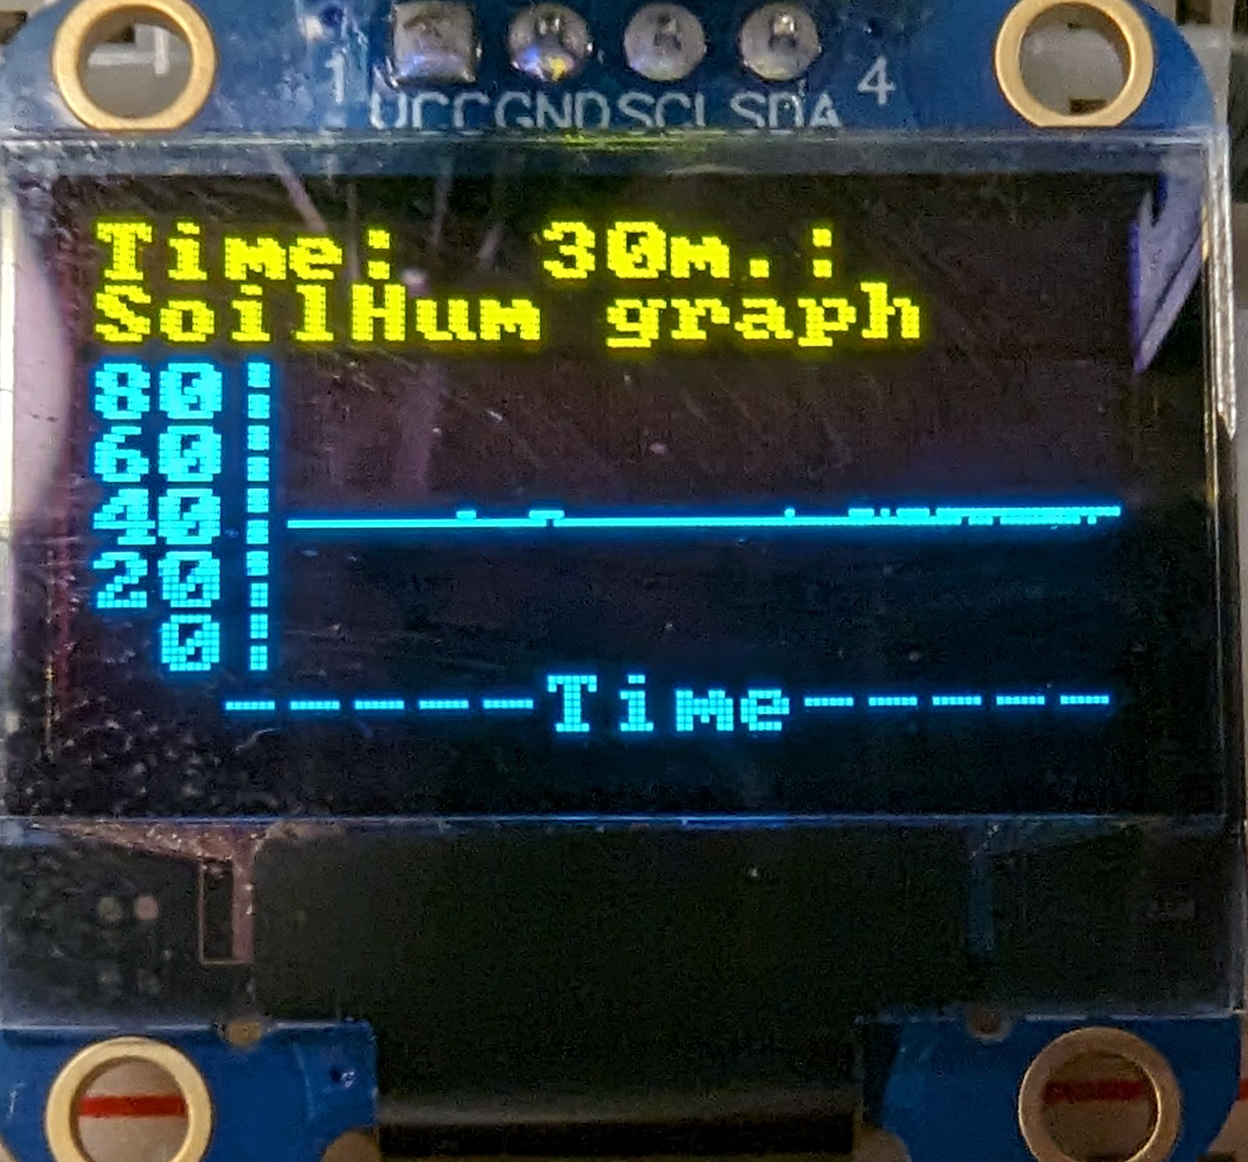
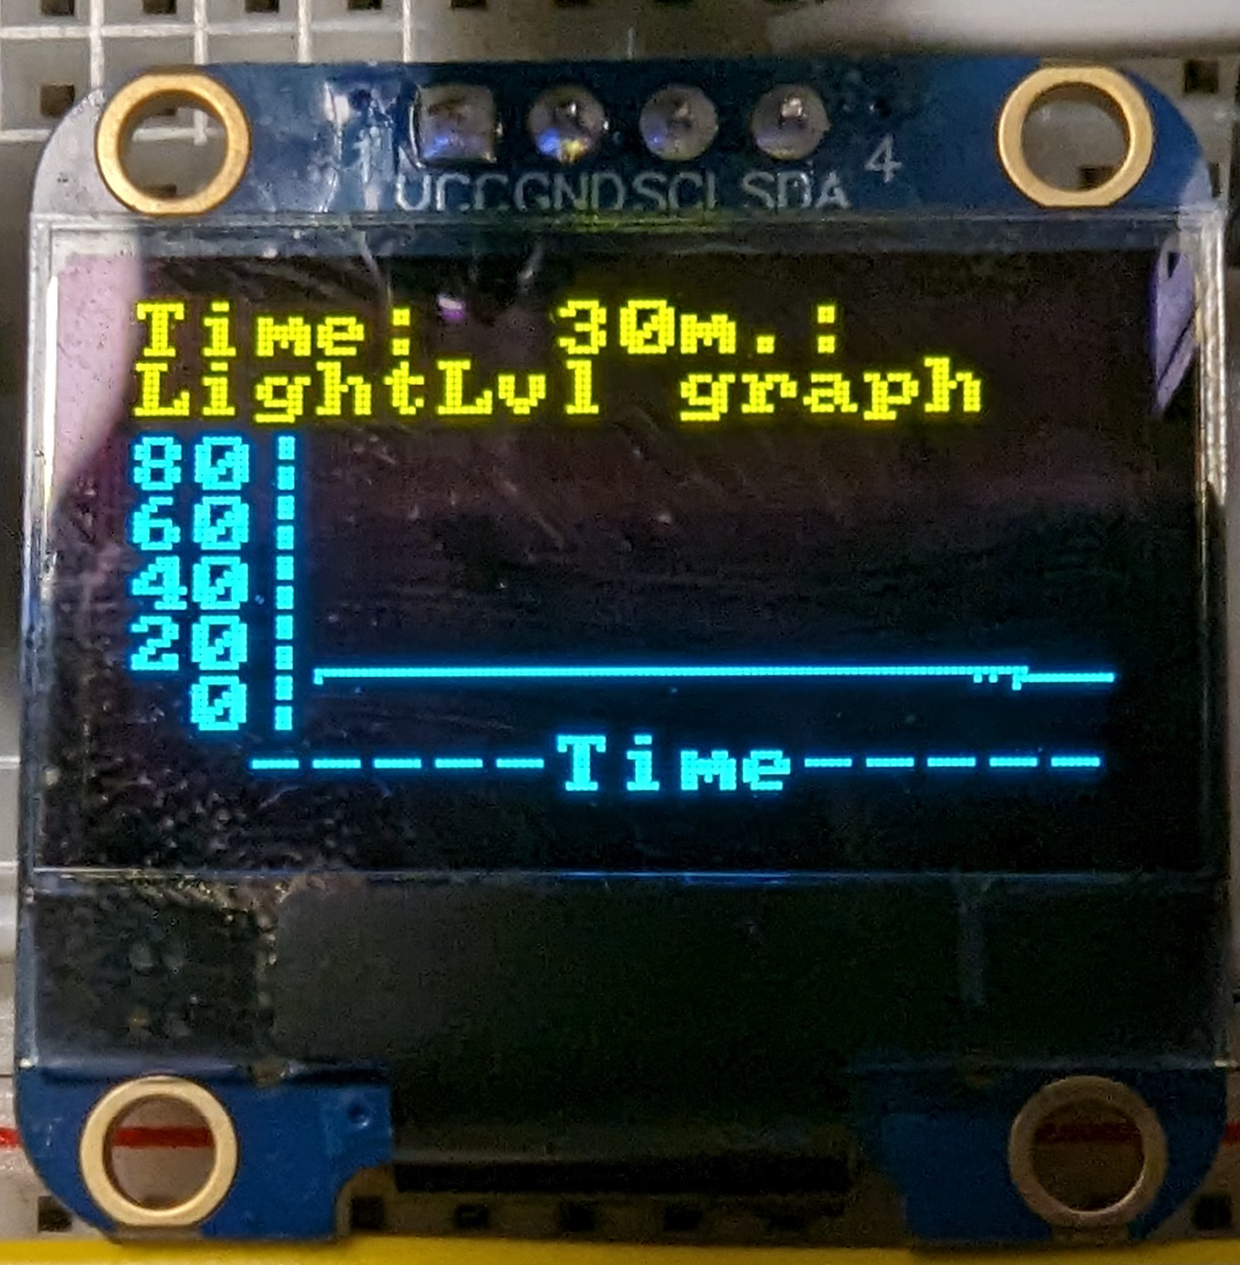
Datacollection: Outside to inside

Slide 5
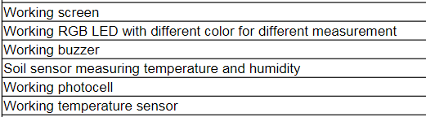
Core Functionality
Air Sensor
Air Temperature and Air Humidity
Soil Sensor
Soil Temperature and Soil Humidity
Light Sensor
Buzzer
Error code LED
By cycling between the different display menus the user can find detailed information about the sensor outputs over time
By pressing the Enter button the user can run experiments for different durations to get average values for all the sensors

Slide 6
Error codes
When the device is powered on the RBG Led will flash light of different colors to indicate that some values are out of the acceptable intervals
RED
Air temperature is out of desired range
YELLOW
Soil temperature is out of desired range
GREEN
Air humidity is out of desired range
BLUE
Soil humumidity is out of desired range
PURPLE
Light level is too low
To get more detailed information about the errors the user can go into the display menu and locate the current values that are causing the problem

Slide 7
Extra Functionality
Boot animation and sound
RGB LED Error codes
Display menu
Functioning buttons
On demand experiments for multiple intervals
Progress % and time remaining
Led indicating when exp. is in progress
Detailed data and data manipulation
Graph on display
Input feedback
Buzzer tone library and music
Animation
(secret)

